Slide 1
What is a Scrum-agile Approach and How Can it Help Us?
A presentation by: Matt Zindler

Slide 2
What is a Scrum Team?
Scrum teams have four main roles, and teams comprising of 3-9 members
The product owner is in charge of being the intermediary between the scrum team and the client ordering the product.
They communicate needs from the customer to the team, as well as update the customer on the team’s progress. They are also in charge of the product backlog, setting the priorities for the team.
The Scrum master ensures that scrum is being followed by the team.
They lead scrum events like the daily scrum, and create sprint reviews and retrospectives as feedback for the team. They also assist the product owner in communication and the backlog.
Developers are the members that design the product.
They are given priorities for the sprint by the product owner to work on and complete by the end. Developers communicate progress and issues in the daily scrum, keeping the team updated.
Testers ensure that the product works as intended.
Testers use user stories and common sense to make sure the developers systems are working as intended. They look for bugs or holes in the logic of the code, and give feedback to developers.

Slide 3
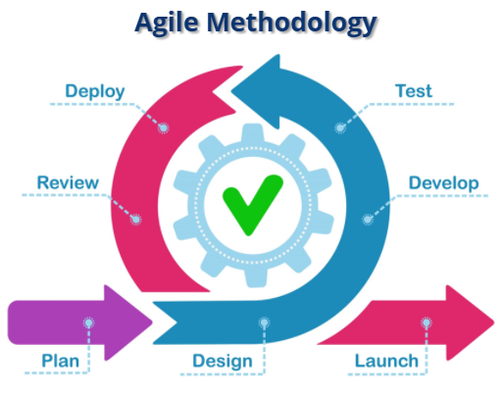
The SDLC for an Agile Approach
The main steps of the software development life cycle in the agile approach are as follows.
Plan, Design, Develop, Test, Deploy, Review, and Launch.
The Internal loop is repeated for each sprint for the project until completion.
The process is meant to be flexible and iterative
Planning or requirement gathering is the first step to the life cycle.
The product owner meets with the client to determine the view for the upcoming project, as well and deciding who should tackle what aspects of the project.
The design phase lays out what is to be created in relation to the product.
Interfaces, databases, hardware and server requirements.
The development and testing phases are where the code is created and tested for issues.
Deployment takes the previously created code, and integrates it into what has already been created for the project.
Reviews are made at the end of the inner cycle to determine if the sprint was a success.
Was everything accomplished, what could be done better next time and so on.
The launch happens after all the code has been created and tested, and approved. The product is ready for the client to use for their own needs.

Slide 4
Agile and Waterfall Development Differences
A waterfall approach to the development of SNHU Travel would have changed the way the product was developed.
After speaking with the customer and gathering requirements, the entire process of development is planned in a direct and rigid manner.
Members of the team would know what is expected of them and when until the products completion.
This gets the project completed but leaves little room for additional requirements or changes in priority for the customer.
A specific example for SNHU Travel, it was determined that many users would be interested in wellness/detox packages, meaning changes in customer stories and priorities.
An agile approach allowed this change to take place without major loss of development time, while a waterfall approach would not have allowed this, as it was not a part of the plan. That change would need to happen as a future development process.

Slide 5
Agile Versus Waterfall Development
Both waterfall and agile have their places when developing a product.
Benefits of waterfall development:
The waterfall method works well when a project has well defined parameters for completion.
Waterfall is well laid out and documented.
Waterfall leads to a very precise working routine for development.
Benefits for an agile approach:
Very iterative, allowing for changes when they are needed.
Modular in development, the program is created piece by piece through each sprint.
High communication between the team and the client.
Which system you wish to choose depends on how flexible you can be, and how much time is available to work with.
SNHU Travel worked well with an agile approach because the client had evolving needs, and the team working on it communicated fast and effectively allowing agile to thrive.

Slide 6
Sources Cited
Blake, S. (2021, February 11). Your guide to agile software development life cycles. Easy Agile. http://www.easyagile.com/blog/agile-software-development-life-cycle/#the-scrum-sdlc-model.
Preston, M. (2021, January 8). 7 phases of the system development life Cycle Guide. Cloud Defense. http://www.clouddefense.ai/blog/system-development-life-cycle.
West, D. (n.d.). Agile scrum roles. Atlassian. https://www.atlassian.com/agile/scrum/roles.

